Slide 1

Project Title –Indian Agriculture Sector Analysis
-Dhananjay Shinde

Slide 2

PROBLEM STATEMENT
Agriculture is vital to India’s economy, yet crop production varies widely across states, districts, and seasons. Lack of clear insights into production trends, land usage, and crop patterns makes it difficult for stakeholders to plan and optimize resources. To overcome this, an interactive Power BI dashboard is needed to analyze and visualize agricultural data for better decision-making.

Slide 3
Project Description The Indian Agriculture Sector Analysis Dashboard is built in Power BI to provide an interactive view of agricultural data across states, districts, crops, and seasons. It visualizes key metrics such as total production, cultivated area, crop distribution, and seasonal trends. The dashboard enables users to filter data by year, state, and crop, helping policymakers, researchers, and stakeholders identify production patterns, compare regional performance, and make data-driven decisions for improving agricultural outcomes.

Slide 4

END USERS
Government agencies & policymakers – to track crop production and plan agricultural policies.
Researchers & analysts – to study trends, patterns, and seasonal impacts.
Farmers & cooperatives – to understand crop performance and optimize farming practices.
Agribusiness companies – to plan supply chain, procurement, and resource allocation.
Educational institutions & students – to learn and analyze real-world agricultural data.

Slide 5

Technology Used
This project is developed using Power BI Desktop, a powerful business intelligence and data visualization tool. Power BI is used for data cleaning, transformation, and creating interactive dashboards. It enables integration of multiple data sources, applying DAX measures, and building visual reports to analyze agricultural trends effectively.

Slide 6
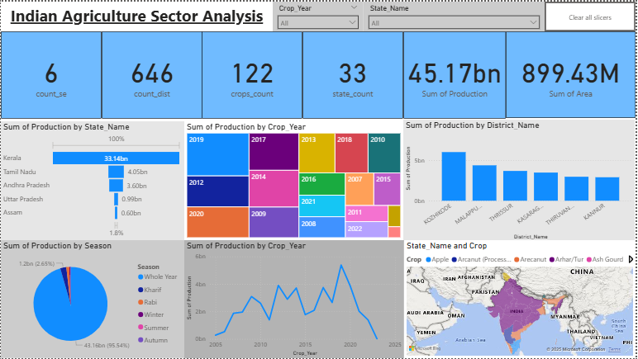
RESULTS

Slide 7
Thank you
.
.

